Slide 1

Marianne M. Jennings
Business
Its Legal, Ethical, and Global Environment
10th Ed.
Chapter 16 Business Competition: Antitrust

Slide 2
Common Law Protections
Covenants Not to Compete
Initially were void
Gradually Became Acceptable
If necessary to protect business
If reasonable as to time
If reasonable as to geographic scope

Slide 3
Negotiating Valid Covenants Not To Compete
State the reason for the covenant
Mix of tenants
Goodwill preservation
Protection of proprietary information
Be sure the covenant is reasonable
Time
Geographic scope
Make the covenant part of the sale, lease, or employment agreement
Have the parties initial the noncompete clause
Have legal representation

Slide 4
Modern Trade Restraints
Case 16.1 Mark-It Place Foods, Inc. v. New Plan Excel Realty Trust (2004)
Discuss the difference between intra- and inter-shopping center competition?
Why is the court willing to allow restrictions in the shopping center?

Slide 5
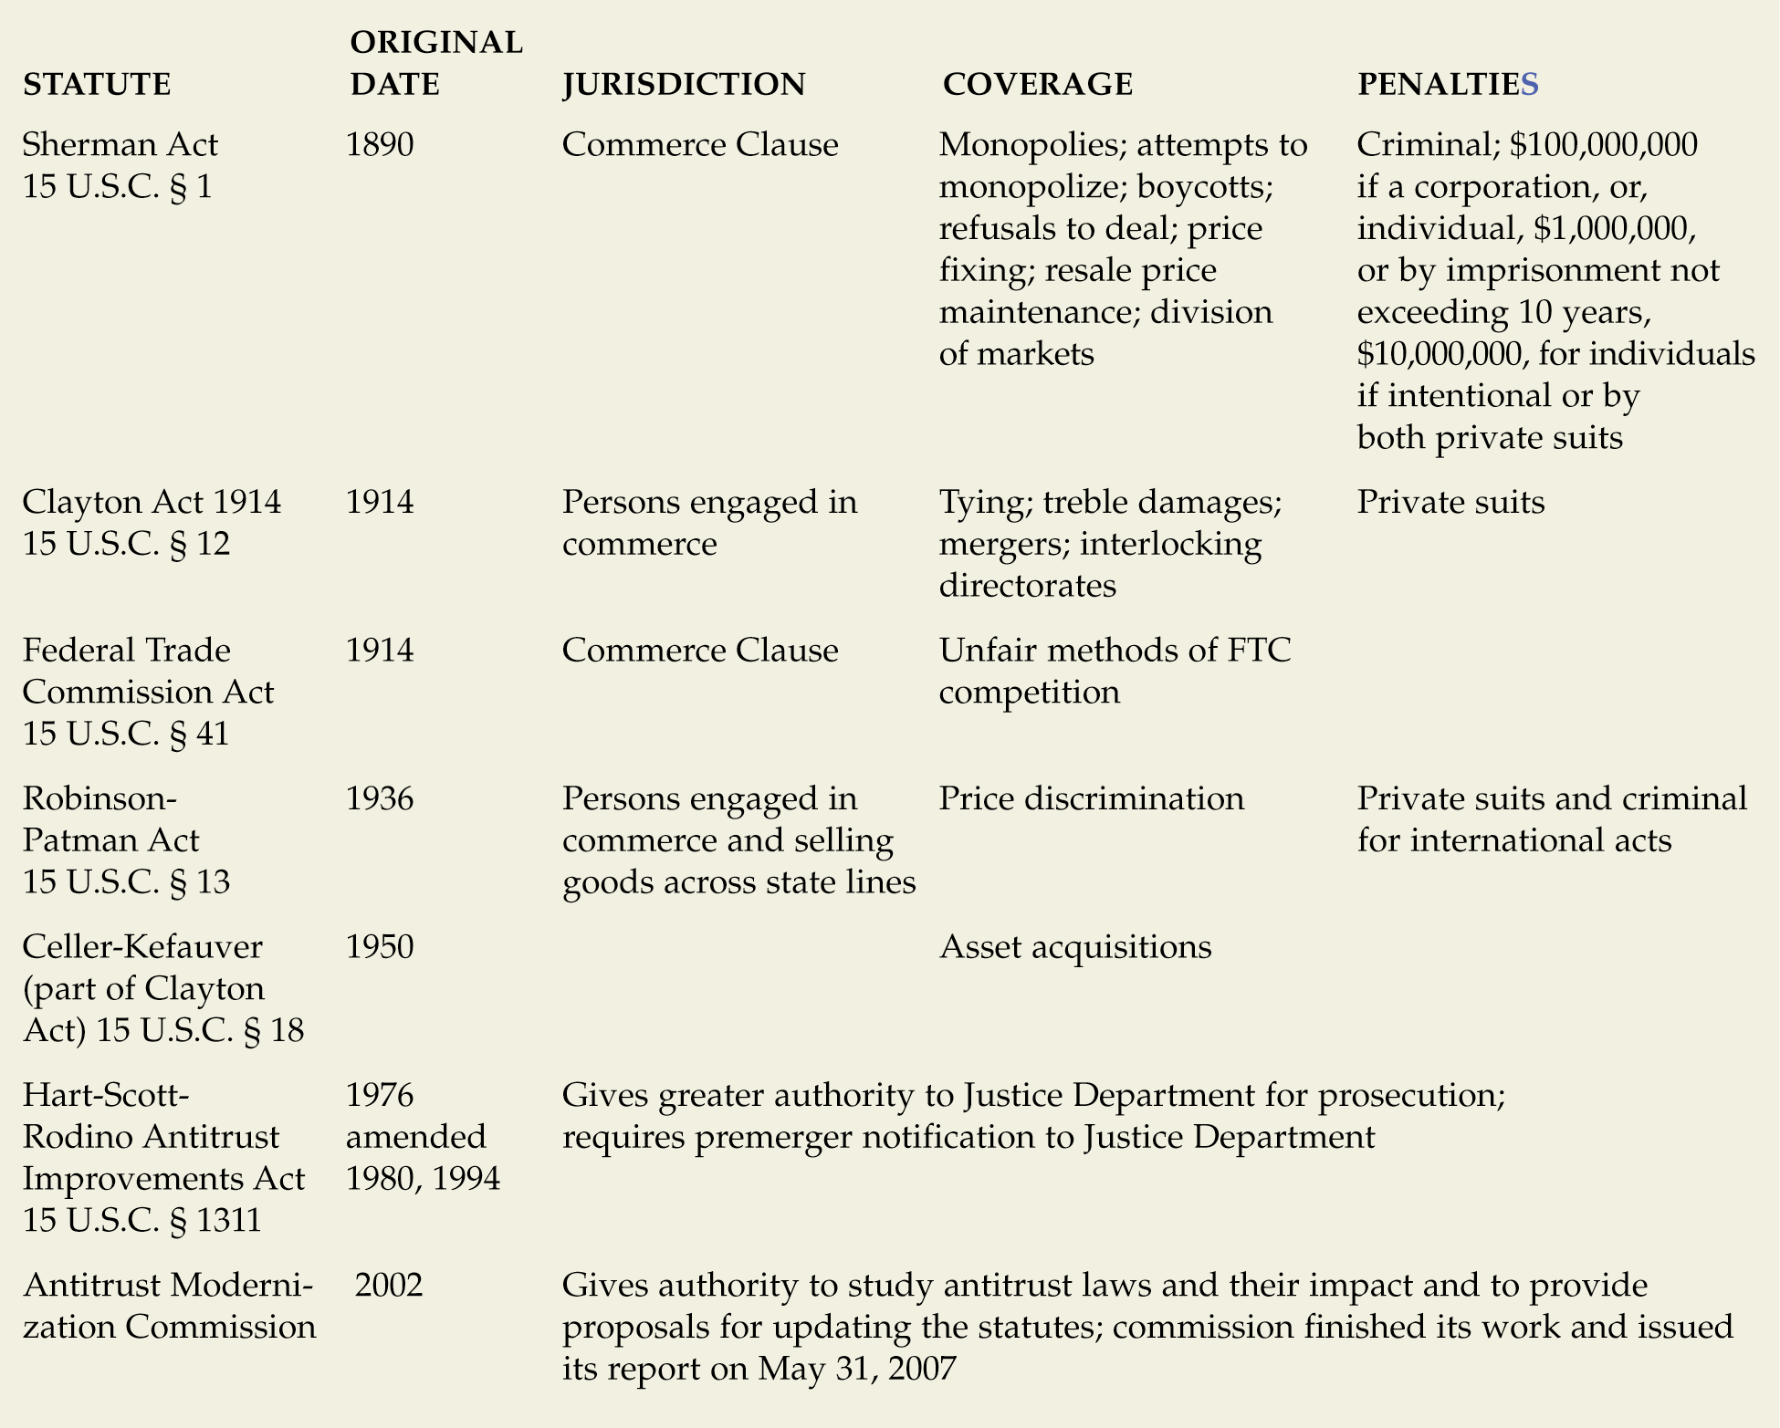
Federal Antitrust Statutes

Slide 6
A Look At Markets, Competition, and Antitrust Laws
HORIZONTAL MARKETS
Monopolization
Price-Fixing
(Sherman Act)
Refusals to deal
Group Boycotts
Mergers Among Competitors
(Clayton Act)
VERTICAL MARKETS
Tying
Monopsony
Price Discrimination
(Robinson-Patman Act)
Resale Price Maintenance
Exclusive Dealing, Sole Outlets, Customer and Territory Restrictions
Mergers Along the Supply Chain
(Clayton Act)

Slide 7
Horizontal Restraints
Designed to Lessen Competition Among a Firm’s Competitors
Examples
Price Fixing
Group boycotts/refusals to deal
Joint Ventures/Mergers/Monopolization

Slide 8
Horizontal Restraints
Sherman Act Restraints—Monopolization
Section 2 prohibits monopolization
Some monopolies are permitted
Newspapers—town cannot support more than one business
Monopoly gained by nature of product—superior skill, foresight, and industry

Slide 9
Horizontal Restraints
Sherman Act Restraints—Monopolization
Monopoly power
Power to control prices or exclude competition in the relevant market
Examine firm’s market power
Examine relevant markets
Geographic market
Product Market

Slide 10
Horizontal Restraints
Sherman Act Restraints—Monopolization
Elements of monopolization
Purposeful act required
Monopoly has resulted from something other than superior skill, foresight, and industry
Predatory pricing—pricing below cost for a temporary period to drive others out
Exclusionary conduct—prevents competitor from entering the market
Attempts to monopolization
Section 2 of Sherman Act may be violated even though no monopoly exists

Slide 11
Horizontal Restraints
Sherman Act Restraints—Price Fixing
Collaboration among competitors for the purpose of raising, depressing, fixing, pegging, or stabilizing the price of a commodity
Per se violation
Conduct is unreasonable and illegal
No defenses for such action

Slide 12
Horizontal Restraints
Sherman Act Restraints—Price Fixing
Minimum prices—discourages competition
Maximum prices—stabilizes prices but see State Oil Co. v. Khan, 522 U.S. 3 (1997)
List prices—exchange of price information hurts market
Production limitations—controls supply and controls price
Limitations on competitive bidding
Credit arrangements—universal agreement on charges is price-fixing

Slide 13
Horizontal Restraints
Division of Markets
Per se violation; lessens competition in that market
Group Boycotts and Refusals to Deal
May have the best intentions in the world but boycotts are still illegal
Example: Garment boycotts on knock-offs

Slide 14
Horizontal Restraints
Free Speech and Anticompetitive Behavior
Noerr-Pennington doctrine
Competitors can work together for governmental action
Lobbying and political efforts
Cannot restrain this activity—First Amendment protection
Local Government Antitrust Act
Exempts state and local government from antitrust suits
Must have state policy to allow suit

Slide 15
Horizontal Restraints
Subtle Anticompetitive Behavior: Interlocking Directorates
Prohibits director of firm with $1 million or more in capital from being a director for a competitor
Lessens likelihood of exchange of anti-competitive information

Slide 16
Horizontal Restraints
Merging Competitors and the Effect on Competition
Presumptively illegal to have horizontal mergers
Courts look at market share to determine true illegality
Today Justice Department follows the Herfindahl-Hirschman Index to evaluate market concentration

Slide 17
Vertical Restraints
Covers Parties in Chain of Distribution
Manufacturer
Wholesaler
Retailer
Resale Price Maintenance
Attempt by manufacturer to control price retailers charge for the product
May be a violation of Section 1
Applies to minimum and maximum prices as well

Slide 18
Vertical Restraints
Case 16.2 State Oil v. Khan (1997)
Is vertical price fixing a per se violation?
What does the court say about long-standing precedent and stare decisis?

Slide 19
Vertical Restraints
Case 16.3 Leegin Creative Leather Products, Inc. v. PSKS, Inc. (2007)
What happened to retailers who discounted the products?
Why does the court see customer service as a part of competition?
Does the court see services as a means of justifying minimum prices?

Slide 20
Vertical Restraints
Monopsony
A monopsony is price control by the buyer
In Weyerhaeuser v. Ross-Simons, the court held that a buyer was not artificially driving up suppler prices through its large orders – its manufacturing process was superior and it needed more supplies just because it could process more

Slide 21
Vertical Restraints
Sole Outlets and Exclusive Distributorships
Manufacturer appoints a distributor or retailer as the exclusive outlet
Subject to a rule of reason analysis: Not automatically illegal; violators can present justification
Factors examined in rule of reason analysis
Manufacturers can pick and choose dealers
There must be inter-brand competition
If there is little inter-brand competition, then intra-brand competition is required

Slide 22
Vertical Restraints
Customer and Territorial Restrictions
Restricting to whom and where a dealer can sell
Subject to a rule of reason analysis
Consider amount of inter-brand competition
Consider market power of manufacturer

Slide 23
Vertical Restraints
Tying Arrangements
Sales arrangements that require buyers to buy an additional product in order to get the product they want
Tying product = desired product
Tied product = additional product

Slide 24
Vertical Restraints
Tying Arrangements
Generally illegal per se violation (Clayton Act Section 3)
Clayton Act—covers goods
Sherman Act—Section 1 covers services, real property, and intangibles
Violation depends on market and power—is tying product unique?

Slide 25
Vertical Restraints
Tying Arrangements: Defenses
New industry defense: needed to protect quality of tying product
Quality control for protection of goodwill specifications are so detailed, could not be supplied by anyone else

Slide 26
Tying Arrangement
Case 16.4 Illinois Tool Works, Inc. v. Independent Ink, Inc. (2006)
Is the arrangement illegal per se?
Is proof of market power required for typing?
Is there a problem with tying unsuccessful products with successful ones?

Slide 27
Vertical Restraints
Price Discrimination
Prohibited by Robinson-Patman Act
Selling goods at prices that have different ratios to the marginal cost of producing them
Required elements (if established, both buyer and seller are guilty)
Interstate commerce
Price discrimination between purchasers
Commodities of like grade and quality
Lessening or injuring competition

Slide 28
Vertical Restraints
Price Discrimination: Defenses
Legitimate cost differences
Quantity discounts OK (if there is an actual savings)
Market changes, inflation, material costs
Meeting the competition

Slide 29
Vertical Restraints
Vertical Mergers: Mergers Between Firms With a Buyer-Seller Relationship
Illegality Depends Upon
Geographic and product markets
Whether entry of competitors would be difficult
Failing Firm Defense
No other offers to buy
Chapter 11 bankruptcy would not help
States Now Have Authority to Step in and Regulate Mergers if Feds Do Not

Slide 30
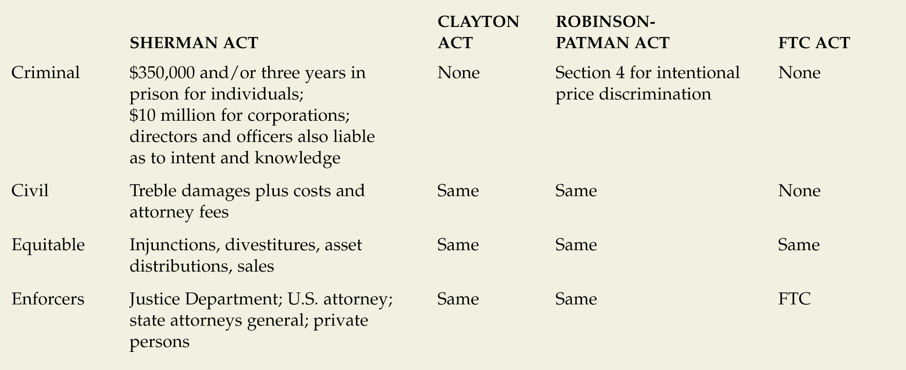
Antitrust Remedies

Slide 31
Antitrust Modernization Commission
Released Its Findings in 2007 After Being Created in 2002
Recommendations Tended to Favor Status Quo
Courts Need to Refine on a Case-by-Case Basis
Courts Should Consider the Economic Issues

Slide 32
International Competition
International Competition and the World Market
United States allows joint ventures in international markets that would not be permitted in the United States
Antitrust laws most stringent in the United States
Foreign companies doing business in the United States are still subject to U.S. Antitrust laws

